Slide 1
Cloud connectivity

Slide 2
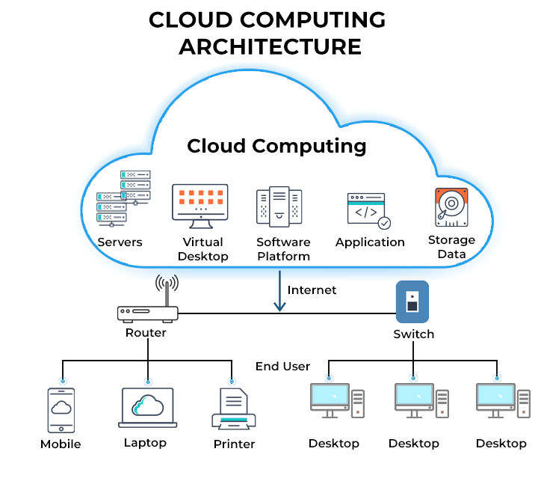
What is Cloud Connectivity?
Cloud connectivity refers to the ability to connect to and access resources and services hosted in the cloud, typically over the internet.
It enables users to access data, applications, and infrastructure from various devices and locations.
Examples of cloud connectivity include connecting to cloud storage services, using cloud-based applications, and accessing virtual machines in the cloud.

Slide 3
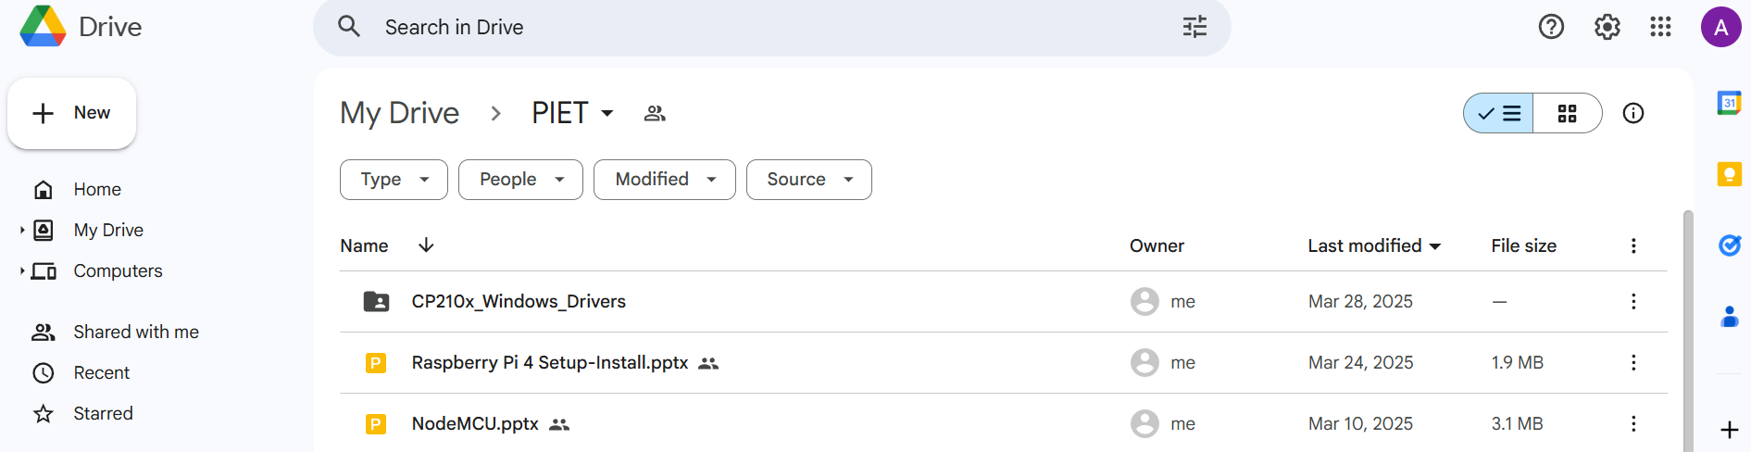
Examples of Cloud Connectivity(p1)
1. Cloud Storage:
Storing files online: Using services like Google Drive, Dropbox, or Microsoft OneDrive to store documents, photos, and other files.
Sharing files: Sharing files with others via cloud storage services, allowing them to access and collaborate on the same documents.
Accessing files from anywhere: Accessing your files from any device with an internet connection.

Slide 4
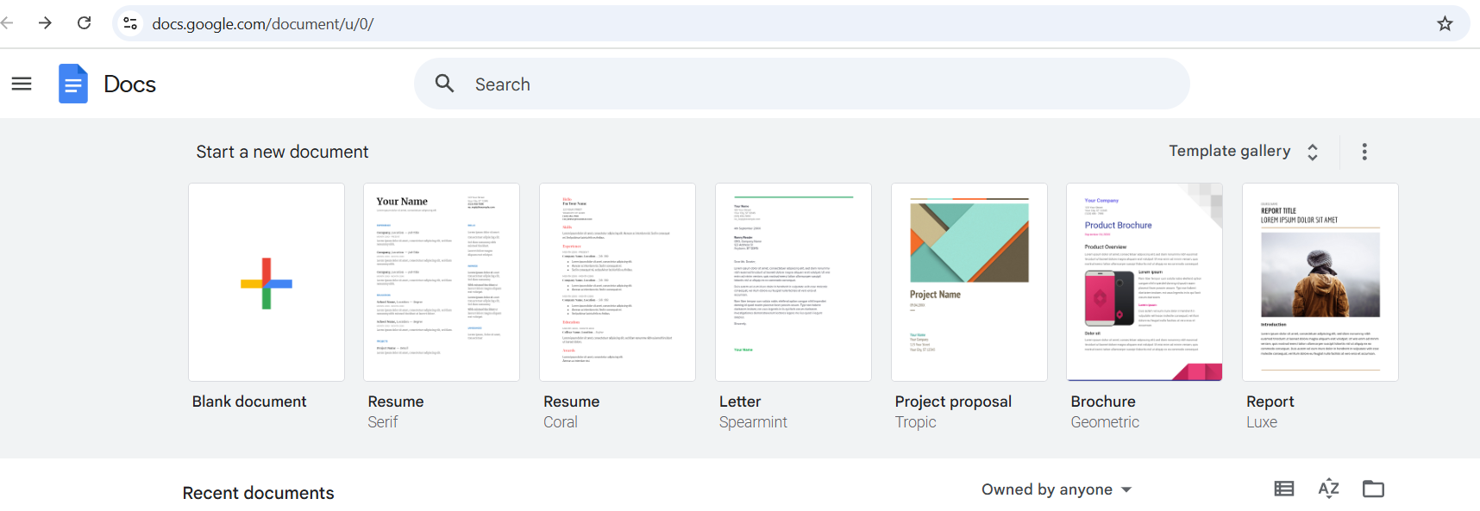
Examples of Cloud Connectivity(p2)
2. Cloud-Based Applications:
Using online office suites: Utilizing applications like Google Docs, Microsoft 365, or Zoho Office to create, edit, and collaborate on documents, spreadsheets, and presentations.
Accessing web applications: Using web-based applications like Gmail, Slack, or Salesforce.
Streaming media: Accessing streaming services like Netflix or Spotify.

Slide 5
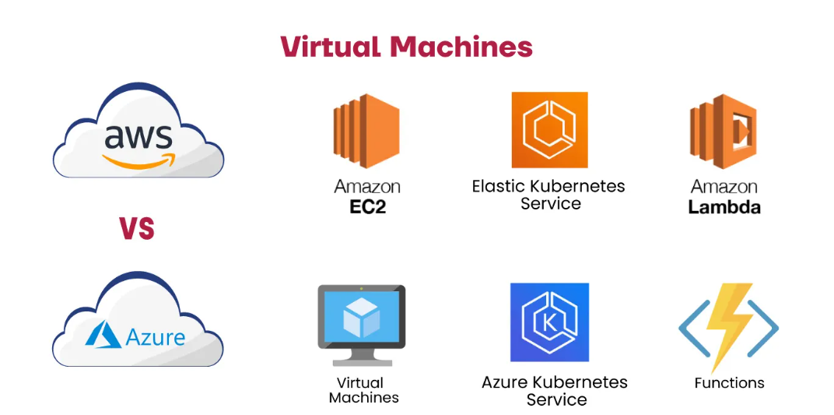
Examples of Cloud Connectivity(p3)
3. Cloud Infrastructure:
Virtual machines: Accessing and managing virtual machines hosted in the cloud.

Slide 6
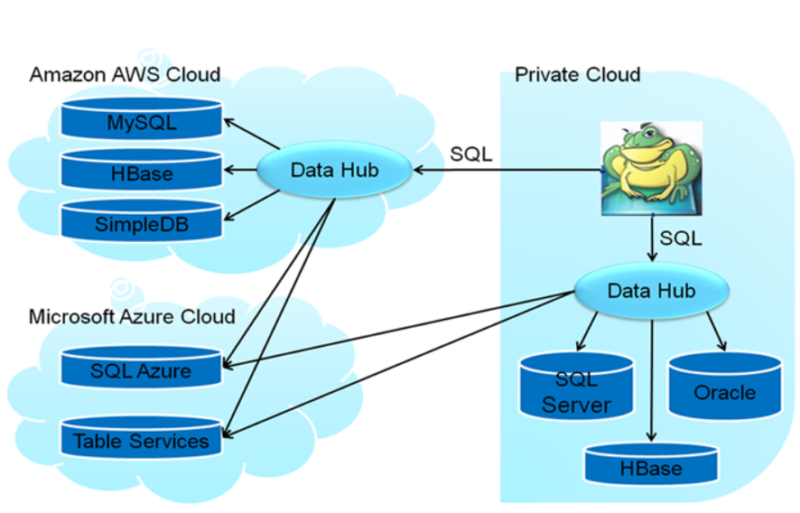
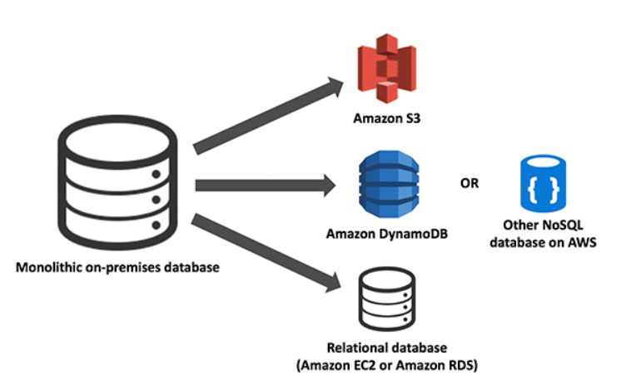
Examples of Cloud Connectivity(p3)
Databases: Connecting to and managing databases hosted in the cloud.
Web hosting: Hosting websites and web applications on cloud platforms.

Slide 7
Examples of Cloud Connectivity(p4)
4. Other examples:
Cloud VPN: Utilizing a cloud VPN to connect to a private network from a remote location.
Cloud networking appliances: Using virtual networking appliances from a networking vendor to handle networking tasks.
Software-defined networking (SDN): Using SDN to manage and control network traffic in a cloud environment.
Every time you call a client using an app like Skype or WhatsApp on your phone, you’re using cloud communications, or more specifically, cloud telephony.

Slide 8
